Slide 1






Complaint Management System
A structured digital workflow for submitting, tracking, and resolving service tickets using standard enterprise design principles.
Presented by Hemalatha R

Slide 2


Problem Statement
Traditional manual complaint management creates operational bottlenecks, lack of accountability, and customer dissatisfaction.
Lack of Real-Time Visibility
Users remain unaware of current complaint progress without digital status tracking.
Inefficient Manual Processing
Manual records lead to duplicate entries, data loss, and administrative strain.

Slide 3









Technology Used
Java
JDBC
MySQL
Serves as the core programming language handling OOP design, business validation, and console interaction.
Executes SQL operations and bridges the application with relational database storage seamlessly.
Relational database management system storing user credentials and organized complaint records.
Eclipse IDE
Layered Architecture
Integrated Development Environment used for compiling, debugging, and managing project dependencies.
Decouples presentation layer, business rules, and database persistence (DAO) to ensure scalable and maintainable code.

Slide 4








Key System Features
Role-Based Access
Complaint Submission
Status Management
DAO CRUD Pattern
Distinct authentication flows separating USER permissions (create/view tickets) from ADMIN controls (status updates).
Intuitive interface allowing users to submit structured complaints with specific categories, titles, and details.
Admins transition complaints through a lifecycle: Pending, In Progress, and Resolved with immediate DB update.
Standardized Data Access Object implementation executing clean SQL queries for user and ticket operations.

Slide 5


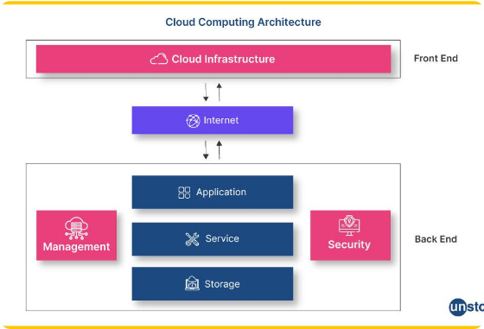







System Architecture
Controller Layer
ComplaintController / Main Menu
Service Layer
ComplaintService / UserService
DAO Layer
ComplaintDAO / UserDAO
Database Layer
MySQL Database (Users & Complaints Tables)

Slide 6
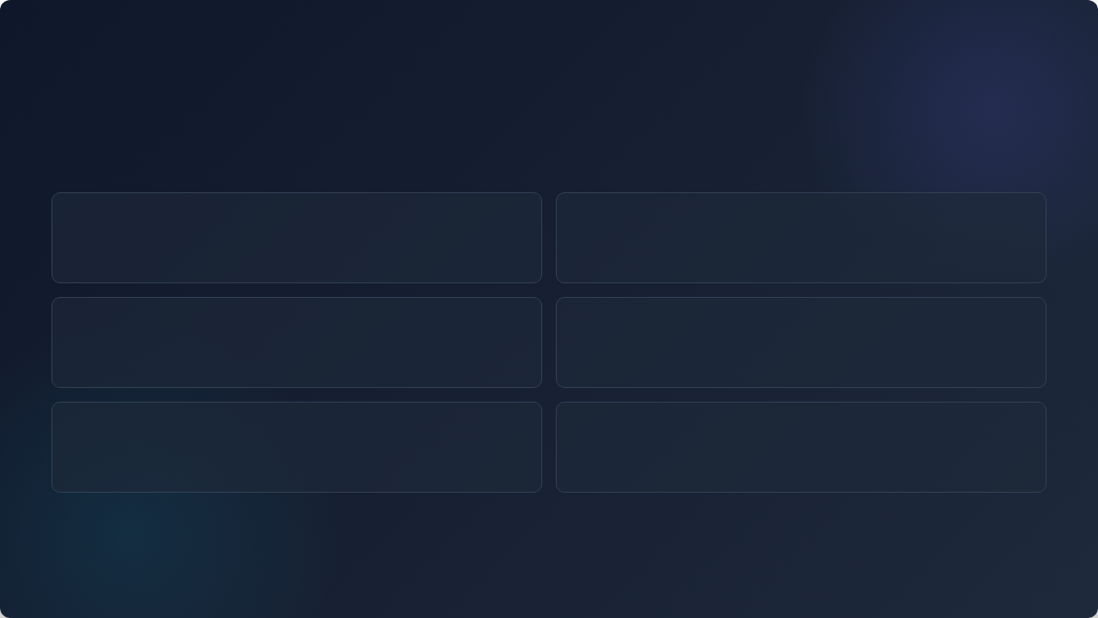






Future Enhancements
Web & Mobile Interface
Automated Notifications
Transition from console UI to a React/Spring Boot responsive web portal and mobile application.
Integrate Email and SMS APIs to notify users instantly when ticket status changes.
Admin Analytics Dashboard
Advanced Security & Hash
Provide visual reports, SLA tracking, and resolution timeline metrics for executive overview.
Implement BCrypt password hashing, JWT authorization, and input sanitization against SQLi.
Media Attachments & Feedback
Smart Filtering & Priority
Allow screenshot uploads and post-resolution satisfaction rating surveys.
Add ticket priority levels (Low, Medium, High) alongside advanced search filters.

Slide 7
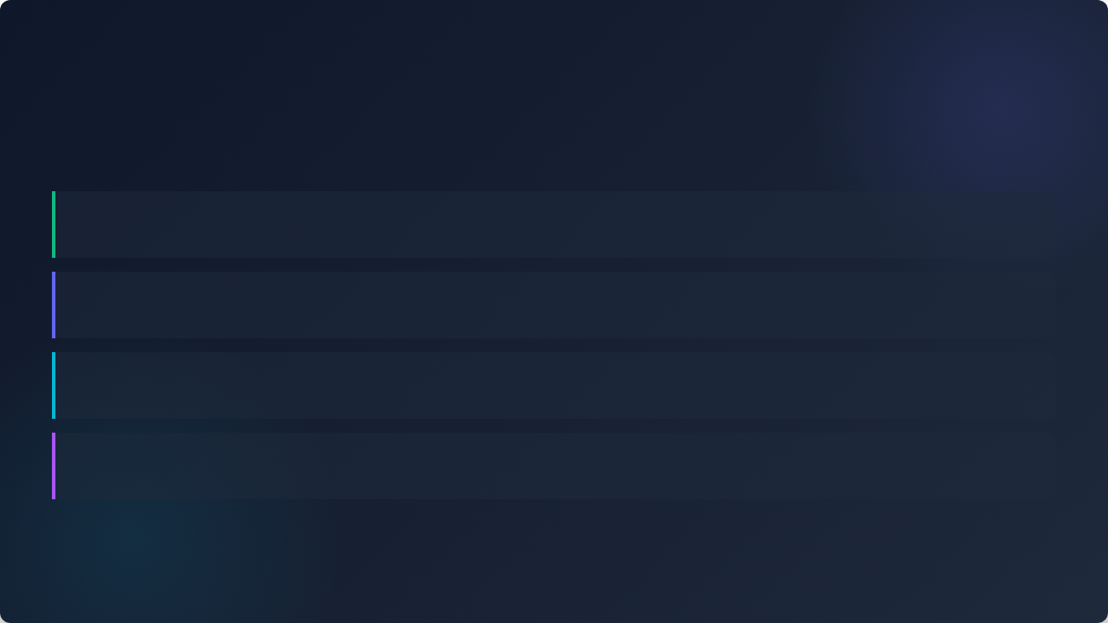
Project Conclusion
Streamlined Digital Workflow
Replaces fragmented manual processing with a structured, centralized digital tracking mechanism.
Clean Modular Architecture
Clear separation of UI, business logic, and JDBC persistence makes the application extensible and easy to test.
Robust Data Consistency
Relational schema design in MySQL paired with Java validation prevents duplicate or inconsistent records.
Scalable Foundation for Enterprise Expansion
The core architecture is ready to be transformed into a full-stack Spring Boot / REST API platform.

Slide 8


Thank You!
Questions & Discussion
Complaint Management System
Built with Java • JDBC • MySQL
Hemalatha R
Project Author & Presenter

Slide 9


Image Sources
https://otrs.com/wp-content/uploads/Service-Desk-Software.jpeg
Source: otrs.com
https://d8it4huxumps7.cloudfront.net/uploads/images/65646c96366aa_cloud_computing_architecture_artboard_2.jpg?d=2000x2000
Source: unstop.com

Slide 10


Image Sources
https://otrs.com/wp-content/uploads/Service-Desk-Software.jpeg
Source: otrs.com
https://d8it4huxumps7.cloudfront.net/uploads/images/65646c96366aa_cloud_computing_architecture_artboard_2.jpg?d=2000x2000
Source: unstop.com

